Slide 1
Cook County Higher Education Community Education Lecture Series
Lecture 2
October 25,2023

Slide 2
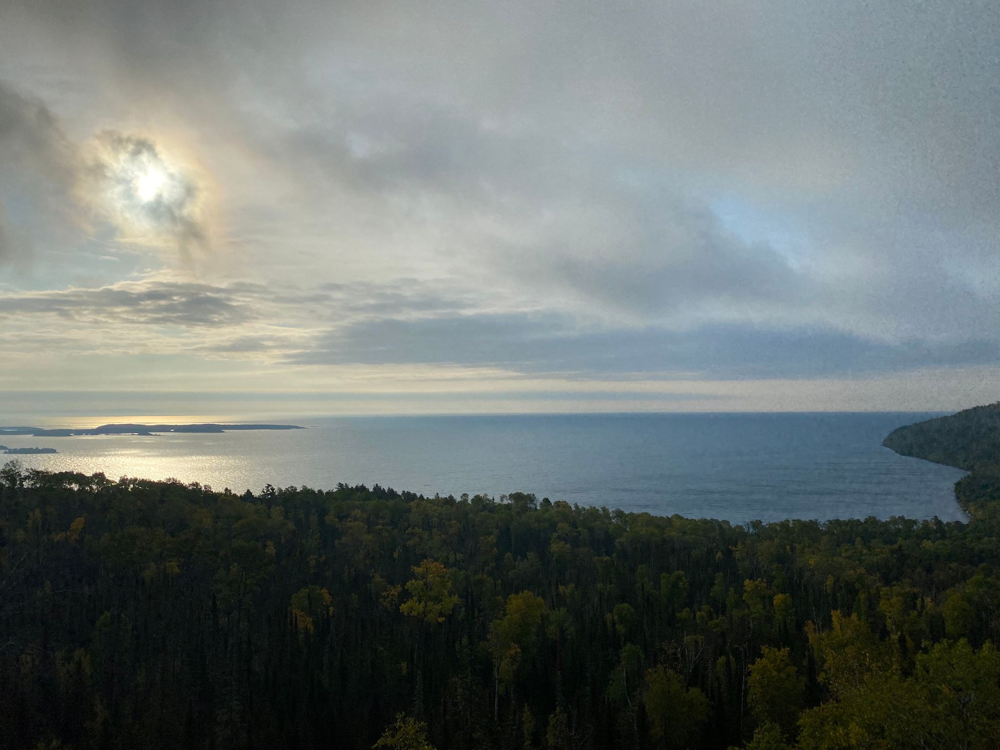
Miigwech

Slide 3
Recap
History as the blueprints of our society
Indigenous borderlands between Dakota and Anishinaabeg mimicking treaty relationship in “Women Who Married The Beaver”
Euro-American sought to break and change that relationship- based on Eurocentric ideas including “Doctrine of Discovery”
Supreme Court Chief Justice John Marshall further defined US-Indigenous nations relationship- Marshall Trilogy
Only Federal Government can purchase lands from Native Nations-based on “Doctrine of Discovery”
Domestic Dependent Nations
State law has no impact in “Indian Country” unless Congress allows it

Slide 4
UNITED NATIONS DEFINITION OF GENOCIDE:
The current definition of Genocide is set out in Article II of the Genocide Convention: Genocide means any of the following acts committed with intent to destroy, in whole or in part, a national, ethnical, racial or religious group, as such:
(a) Killing members of the group;
(b) Causing serious bodily or mental harm to members of the group;
(c) Deliberately inflicting on the group conditions of life calculated
to bring about its physical destruction in whole or in part;
(d) Imposing measures intended to prevent births within the group;
(e) Forcibly transferring children of the group to another group.

Slide 5
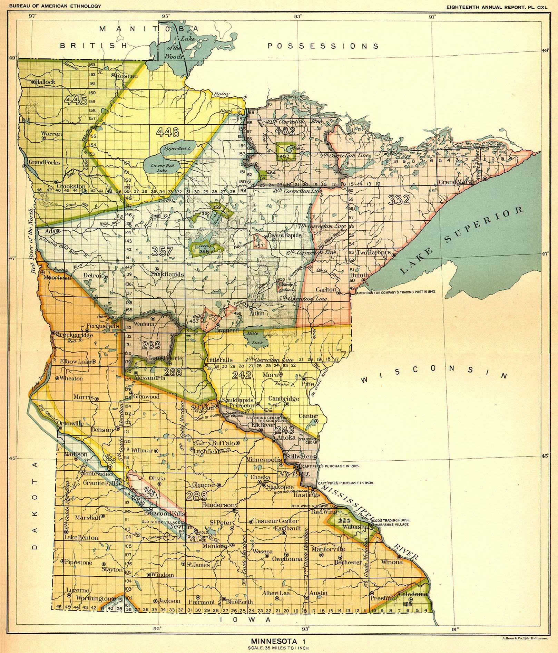
Royce Map: Treaty Cession Map

Slide 6
SAVANNA PORTAGE TRAIL NEAR SANDY LAKE
Sandy Lake Tragedy 1850
Estimates of 400 individuals died due to disease, starvation, and governmental inaction

Slide 7
Dakota War of 1862

Slide 8
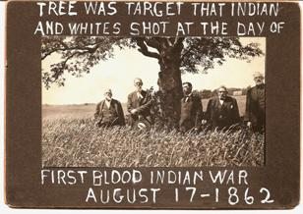
Beginning of Dakota War
Four young Dakota hunters killed five white settlers at Acton township

Slide 9
Little Crow
c. 1810-July 3, 1863
Born near modern day South Saint Paul, MN
Shot and killed after Dakota War while collecting berries
Scalp and skull turned in for reward money returned to family in 1971

Slide 10
Mankato Prison Camp

Slide 11
Bounty Paid for Little Crow

Slide 12
Western Wars

Slide 13
Nez Perce Route

Slide 14
UNITED NATIONS DEFINITION OF GENOCIDE:
The current definition of Genocide is set out in Article II of the Genocide Convention: Genocide means any of the following acts committed with intent to destroy, in whole or in part, a national, ethnical, racial or religious group, as such:
(a) Killing members of the group;
(b) Causing serious bodily or mental harm to members of the group;
(c) Deliberately inflicting on the group conditions of life calculated
to bring about its physical destruction in whole or in part;
(d) Imposing measures intended to prevent births within the group;
(e) Forcibly transferring children of the group to another group.

Slide 15
Boarding Schools

Slide 16
Richard Pratt
December 6, 1840- March 15, 1924
Fought for Union during Civil War later rejoined served with 10th Cavalry famed “Buffalo Soldiers”

Slide 17
Florida Education Experiment

Slide 18
Assimilation through education

Slide 19
Carlisle Indian School

Slide 20
“Kill the Indian Save the Man”

Slide 21
Summer Work Program

Slide 22
Canadian Residential Schools

Slide 23
UNITED NATIONS DEFINITION OF GENOCIDE:
The current definition of Genocide is set out in Article II of the Genocide Convention: Genocide means any of the following acts committed with intent to destroy, in whole or in part, a national, ethnical, racial or religious group, as such:
(a) Killing members of the group;
(b) Causing serious bodily or mental harm to members of the group;
(c) Deliberately inflicting on the group conditions of life calculated
to bring about its physical destruction in whole or in part;
(d) Imposing measures intended to prevent births within the group;
(e) Forcibly transferring children of the group to another group.

Slide 24
Suggested Readings
Erik M. Redix The Murder of Joe White: Ojibwe Leadership and Colonialism in Wisconsin (2014)
Gwen Westerman and Bruce White. Mni Sota Makoce: The Land of the Dakota (2012).
Waziyatawin. What Does Justice Look Like?: The Struggle for Liberation in Dakota Homeland (2008).
Brenda J. Child Boarding School Seasons: American Indian Families, 1900-1940 (2000).
Jacqueline Fear-Segal and Susan D. Rose. Carlisle Indian Industrial School: Indigenous Histories, Memories, & Reclamations (2016).

Slide 25
Miigwech!
Contact Information
Jacob Jurss
Century College
jacob.jurss@century.edu

