Slide 1
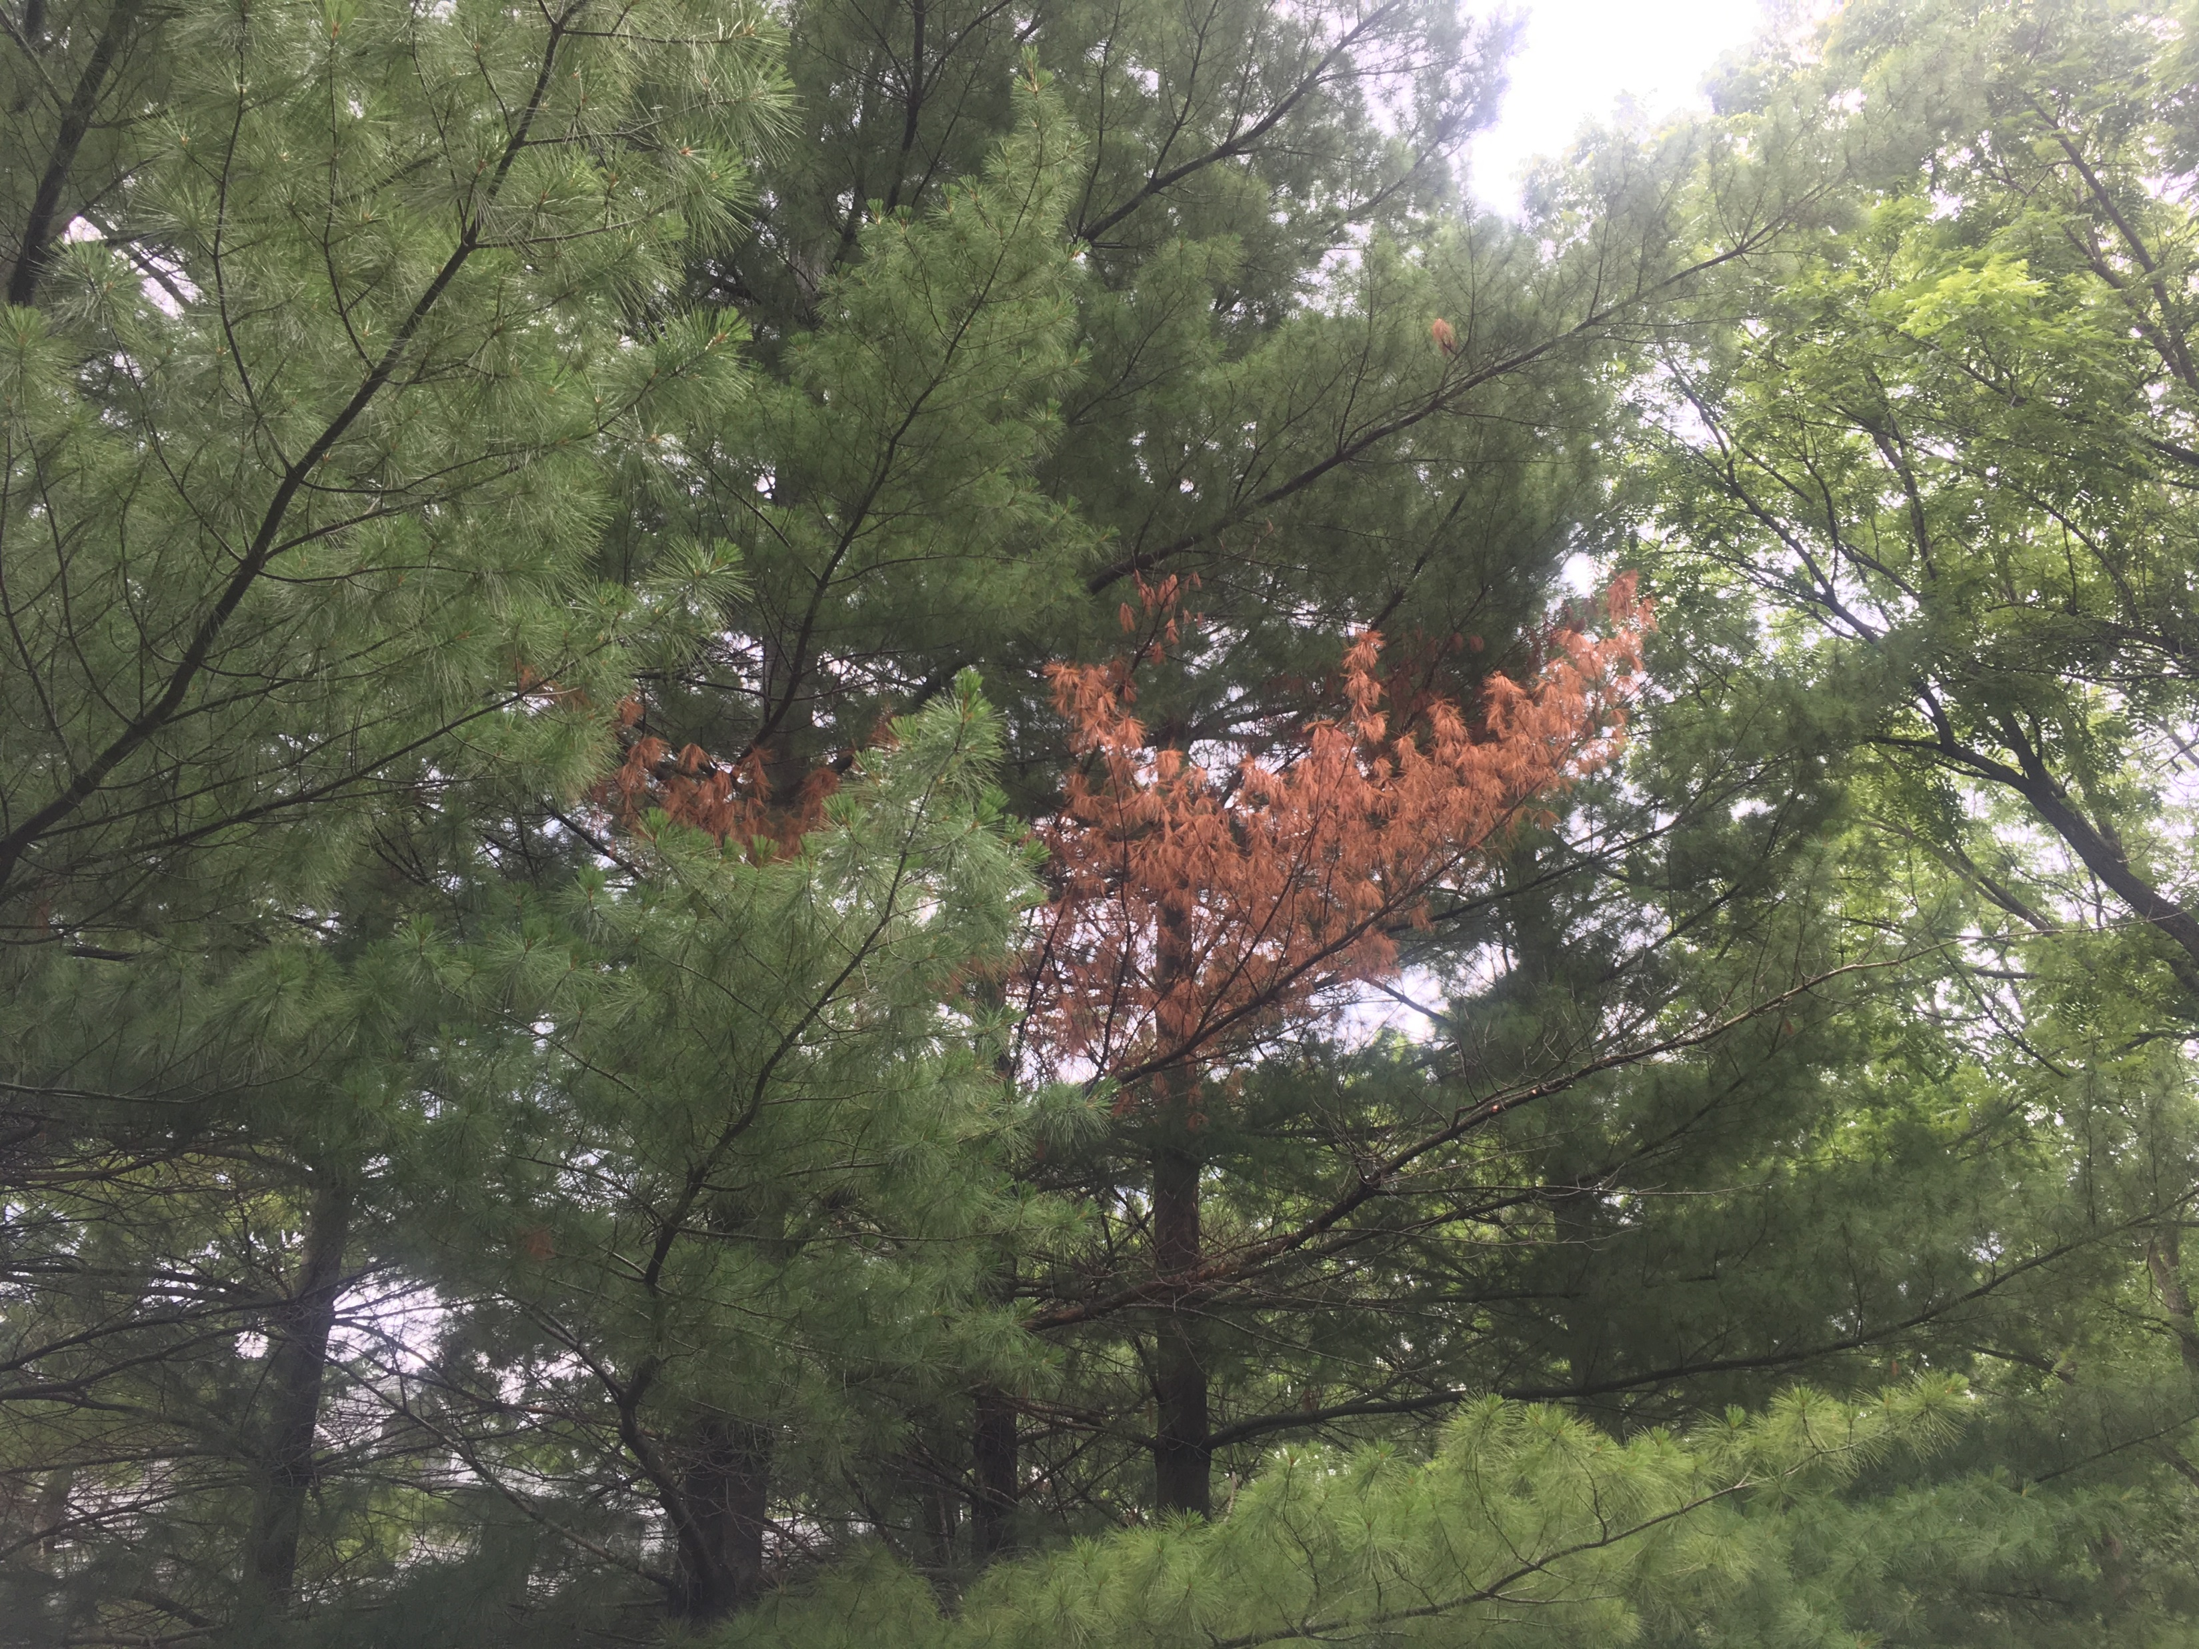
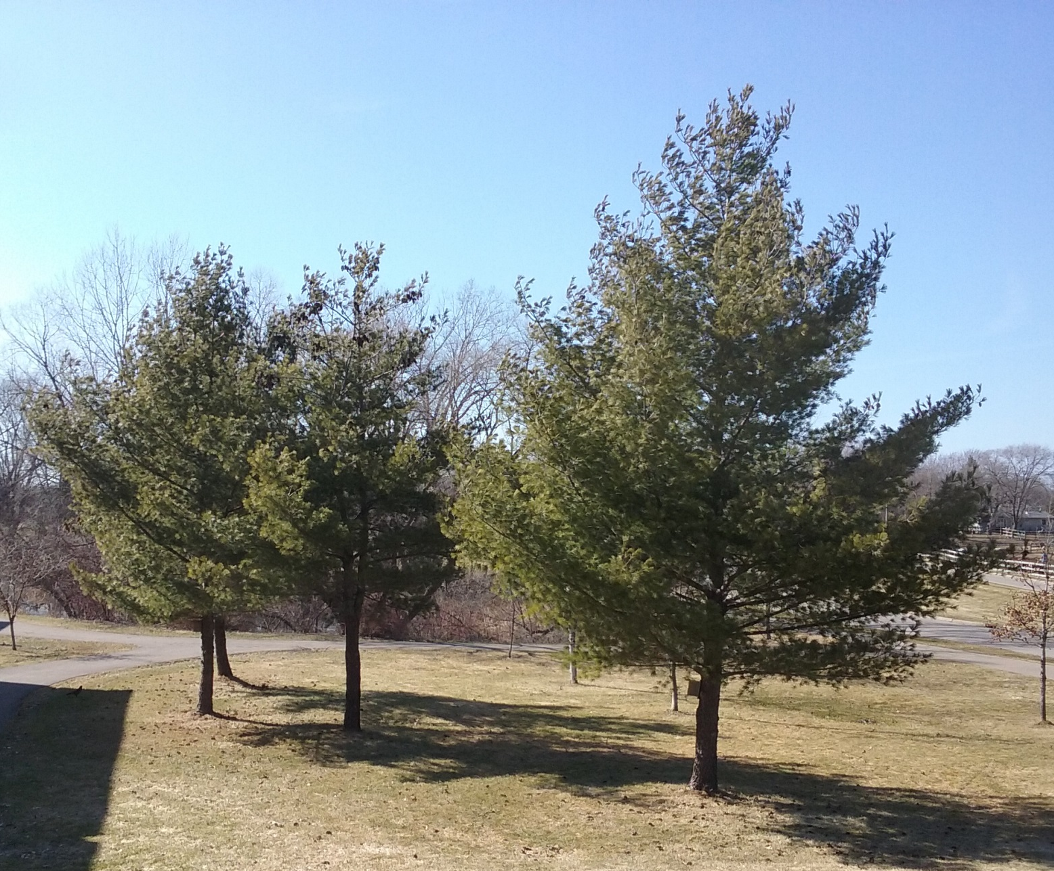
White Pine Blister Rust Management Recommendations
Eric Otto| Forest Health Specialist
NSFC Virtual Landowner Meeting
12/16/2022

Slide 2
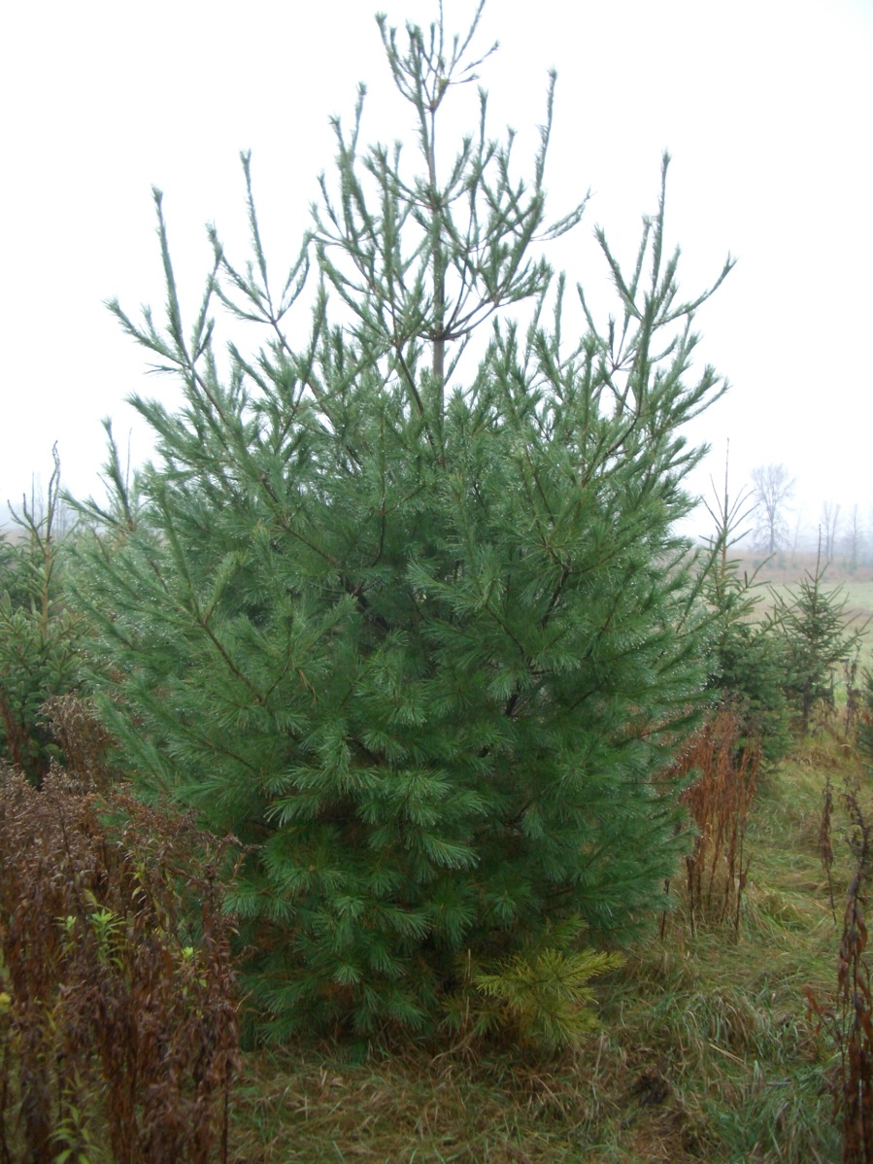
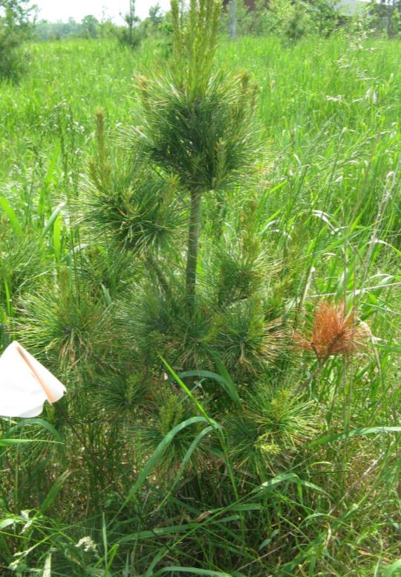
Prune to prevent blister rust
>99% of infections occur within 9 feet of the ground

Slide 3
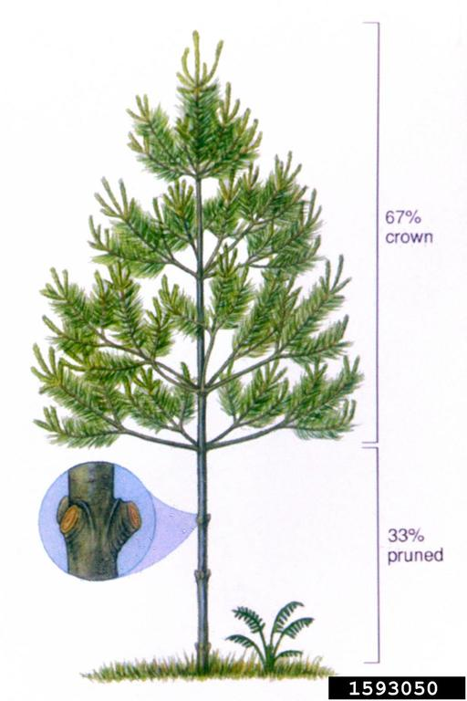
How to prune
Pruning can start when trees are about 5 years old and 2 feet tall or more
Prune lowest branches off the trees
Leave 2/3 of the live crown
Pruning should continue to a minimum height of 9 feet and 17 feet is ideal
Steven Katovich, Bugwood.org

Slide 4
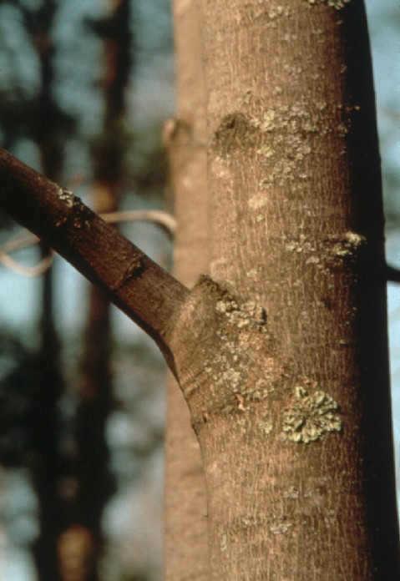
How to prune
Pruning cuts should be made just outside the branch collar
Do not flush cut the branches
Prune outside the branch collar
Pruning tool dependent on diameter of branches
Pruning can take place almost anytime of year, but best during the fall and winter when the tree is dormant
Prune here
Branch collar

Slide 5
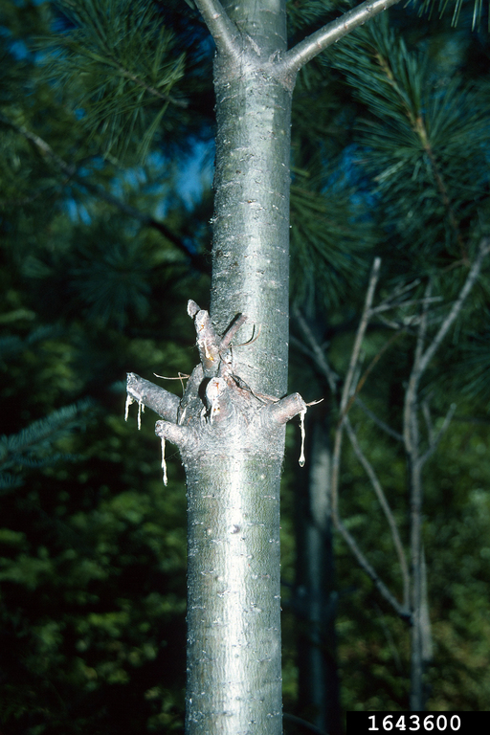
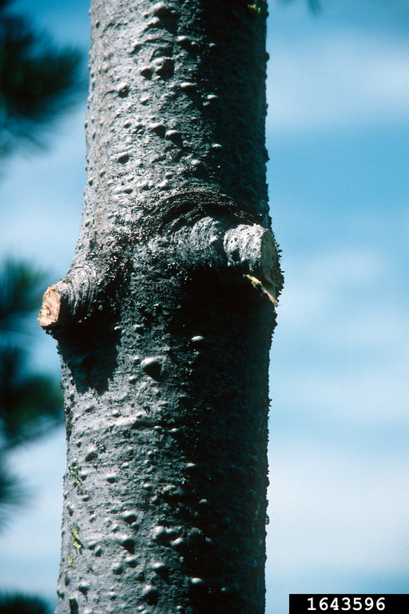
USDA Forest Service - Coeur d’Alene Field Office , Bugwood.org
USDA Forest Service - Coeur d’Alene Field Office , Bugwood.org
Poor pruning

Slide 6
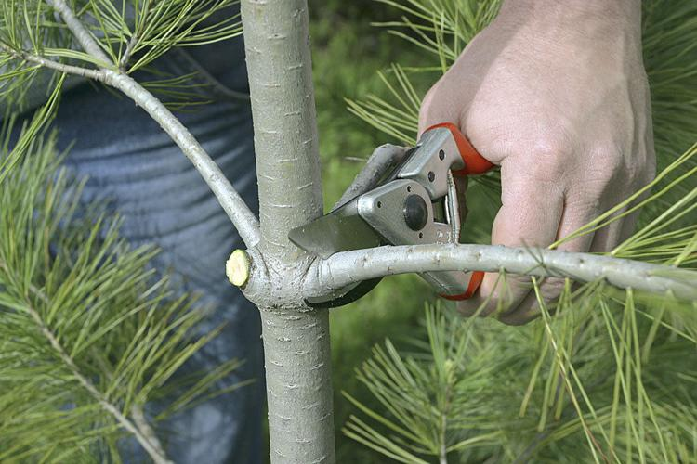
Chris Schnepf, University of Idaho
Prune to the branch collar

Slide 7
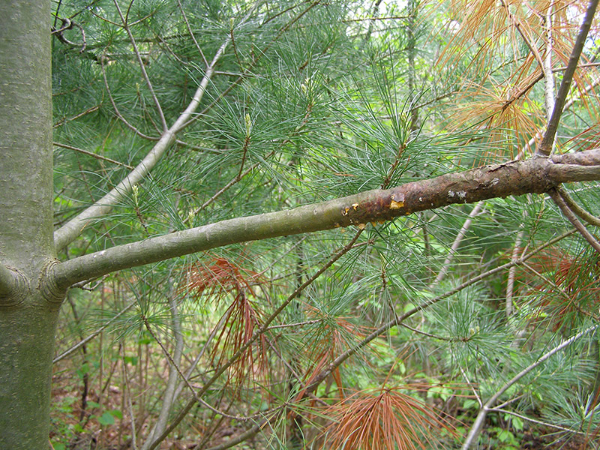
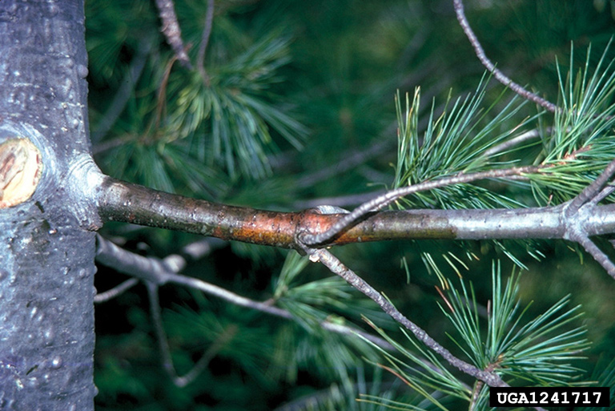
Pruning infected branches
Branches with cankers beyond 4 inches from the stem should be removed
If the canker is within 4 inches of the main stem then pruning will not prevent the spread
Pruning tools don’t need to be sanitized
Pruned branches won’t spread the disease
University of Minnesota Extension
John W. Schwandt, USDA Forest Service, Bugwood.org

Slide 8
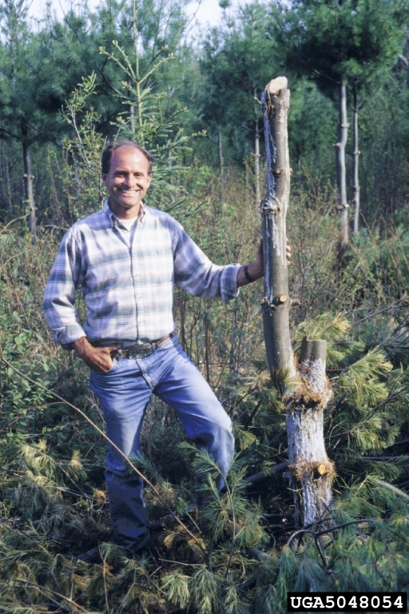
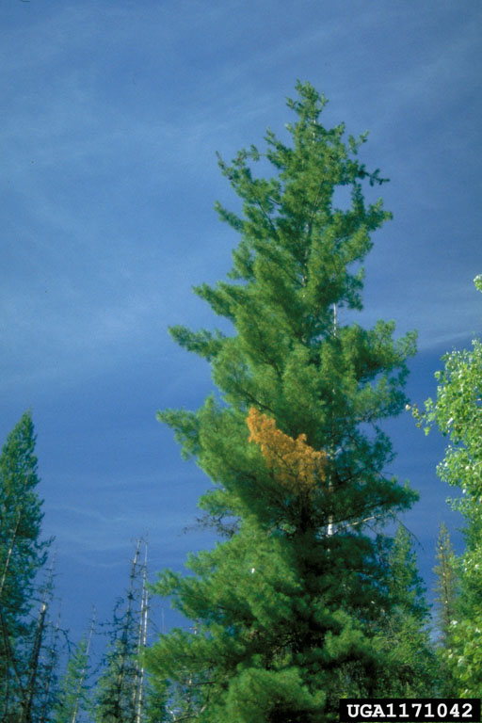
Pruning will not save every tree
Infections can occur anywhere
An infection can take years to recognize
Don’t over prune!
Chris Schnepf, University of Idaho, Bugwood.org
Joseph O’Brien, USDA Forest Service, Bugwood.org

Slide 9
Prune up white pine canopies to minimize blister rust risk

Slide 10
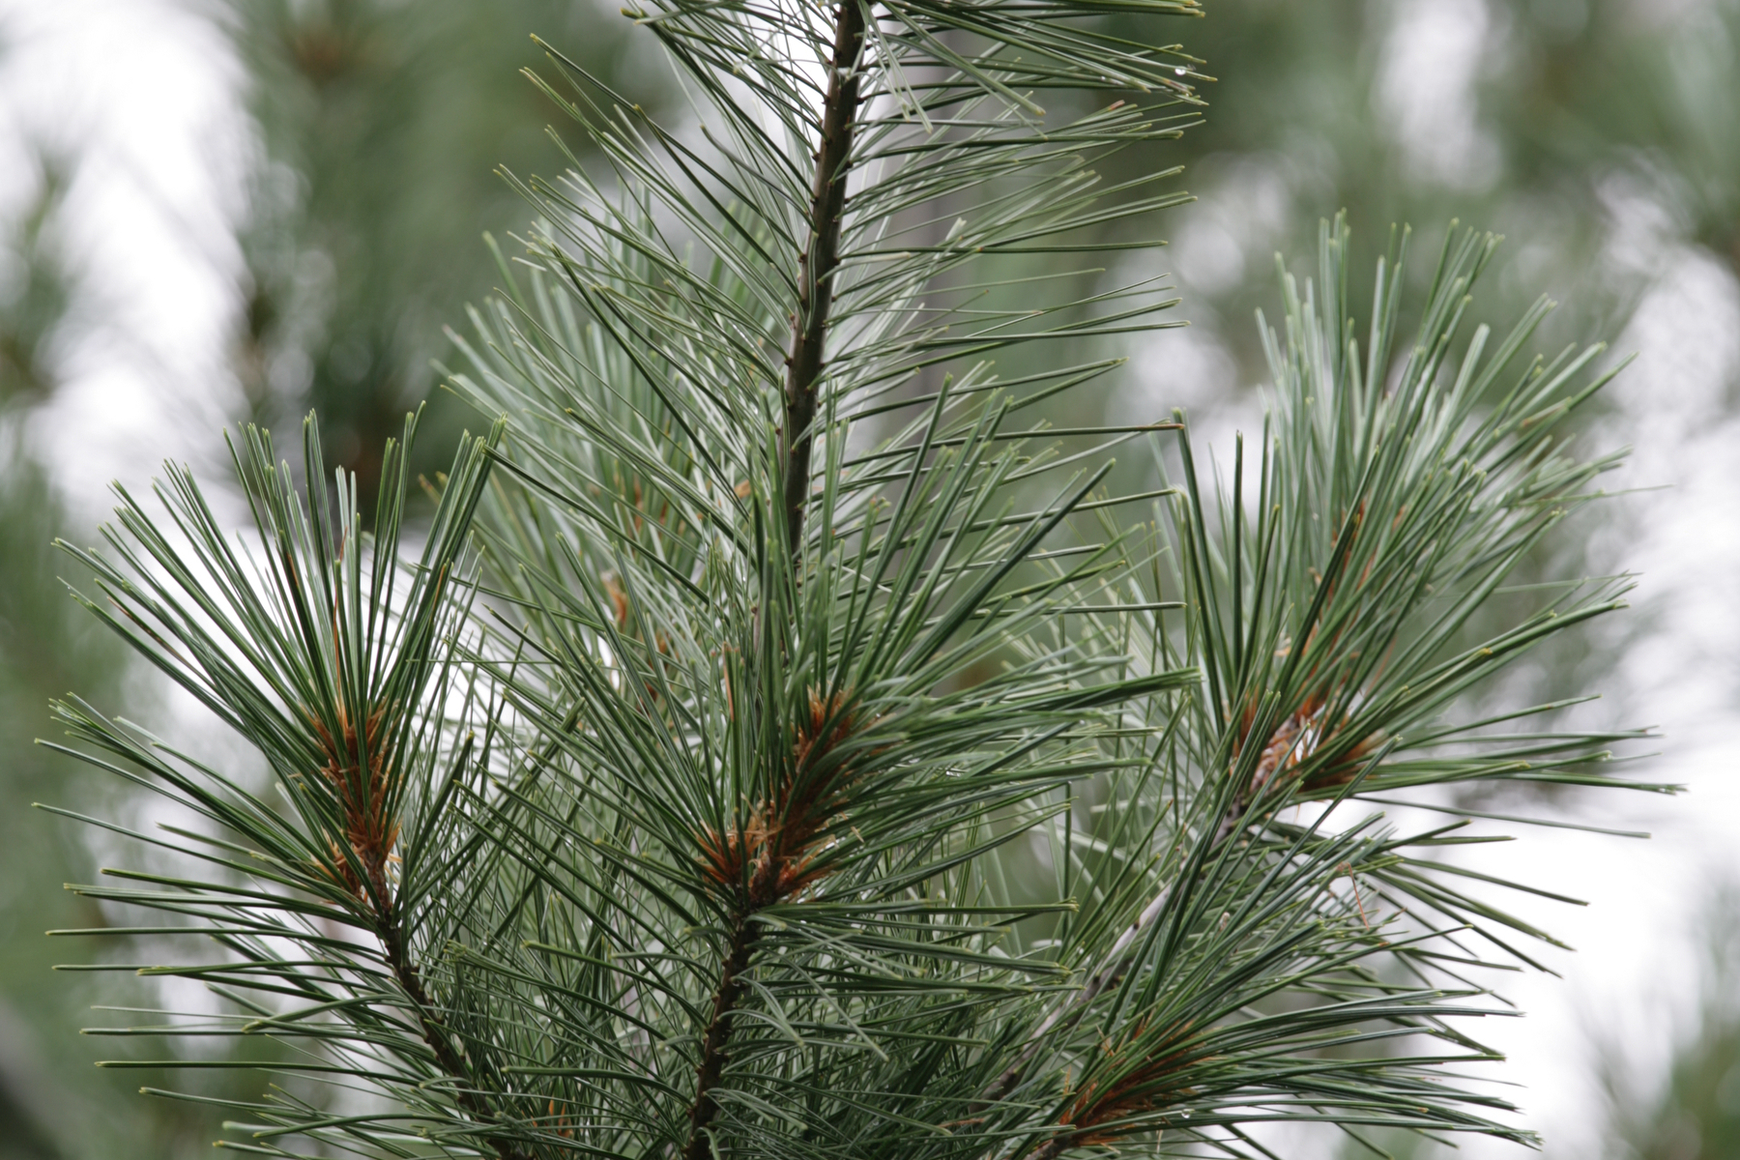
Recommendations for planting material
Plant resistant white pine trees
Patton’s Silver Splendor
Minnesota Nursery Research Corporation

Slide 11
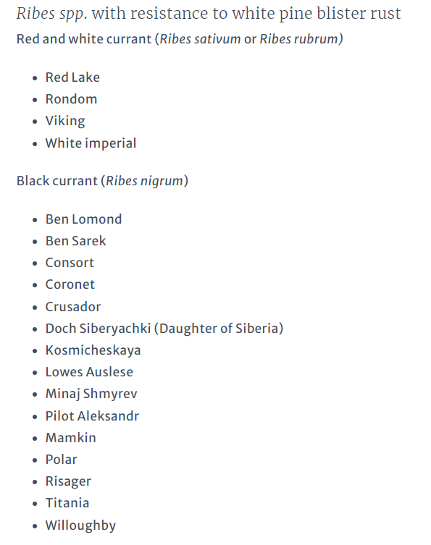
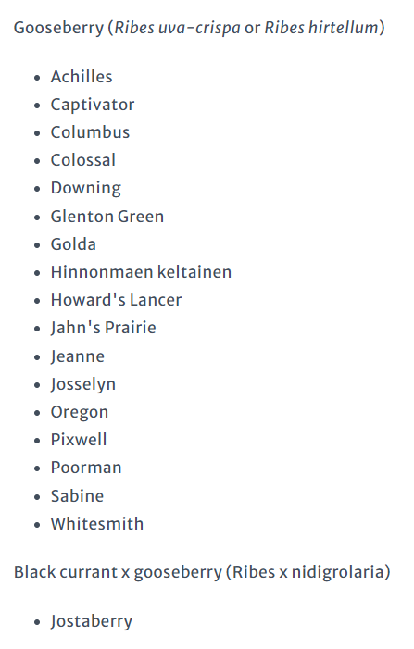

Slide 12
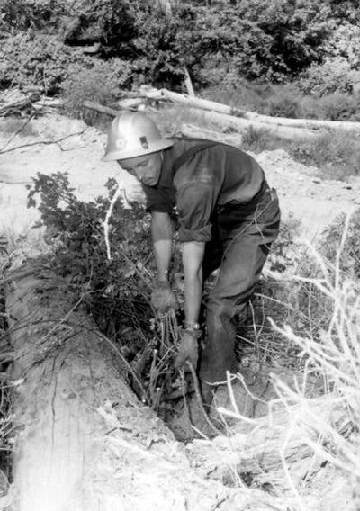
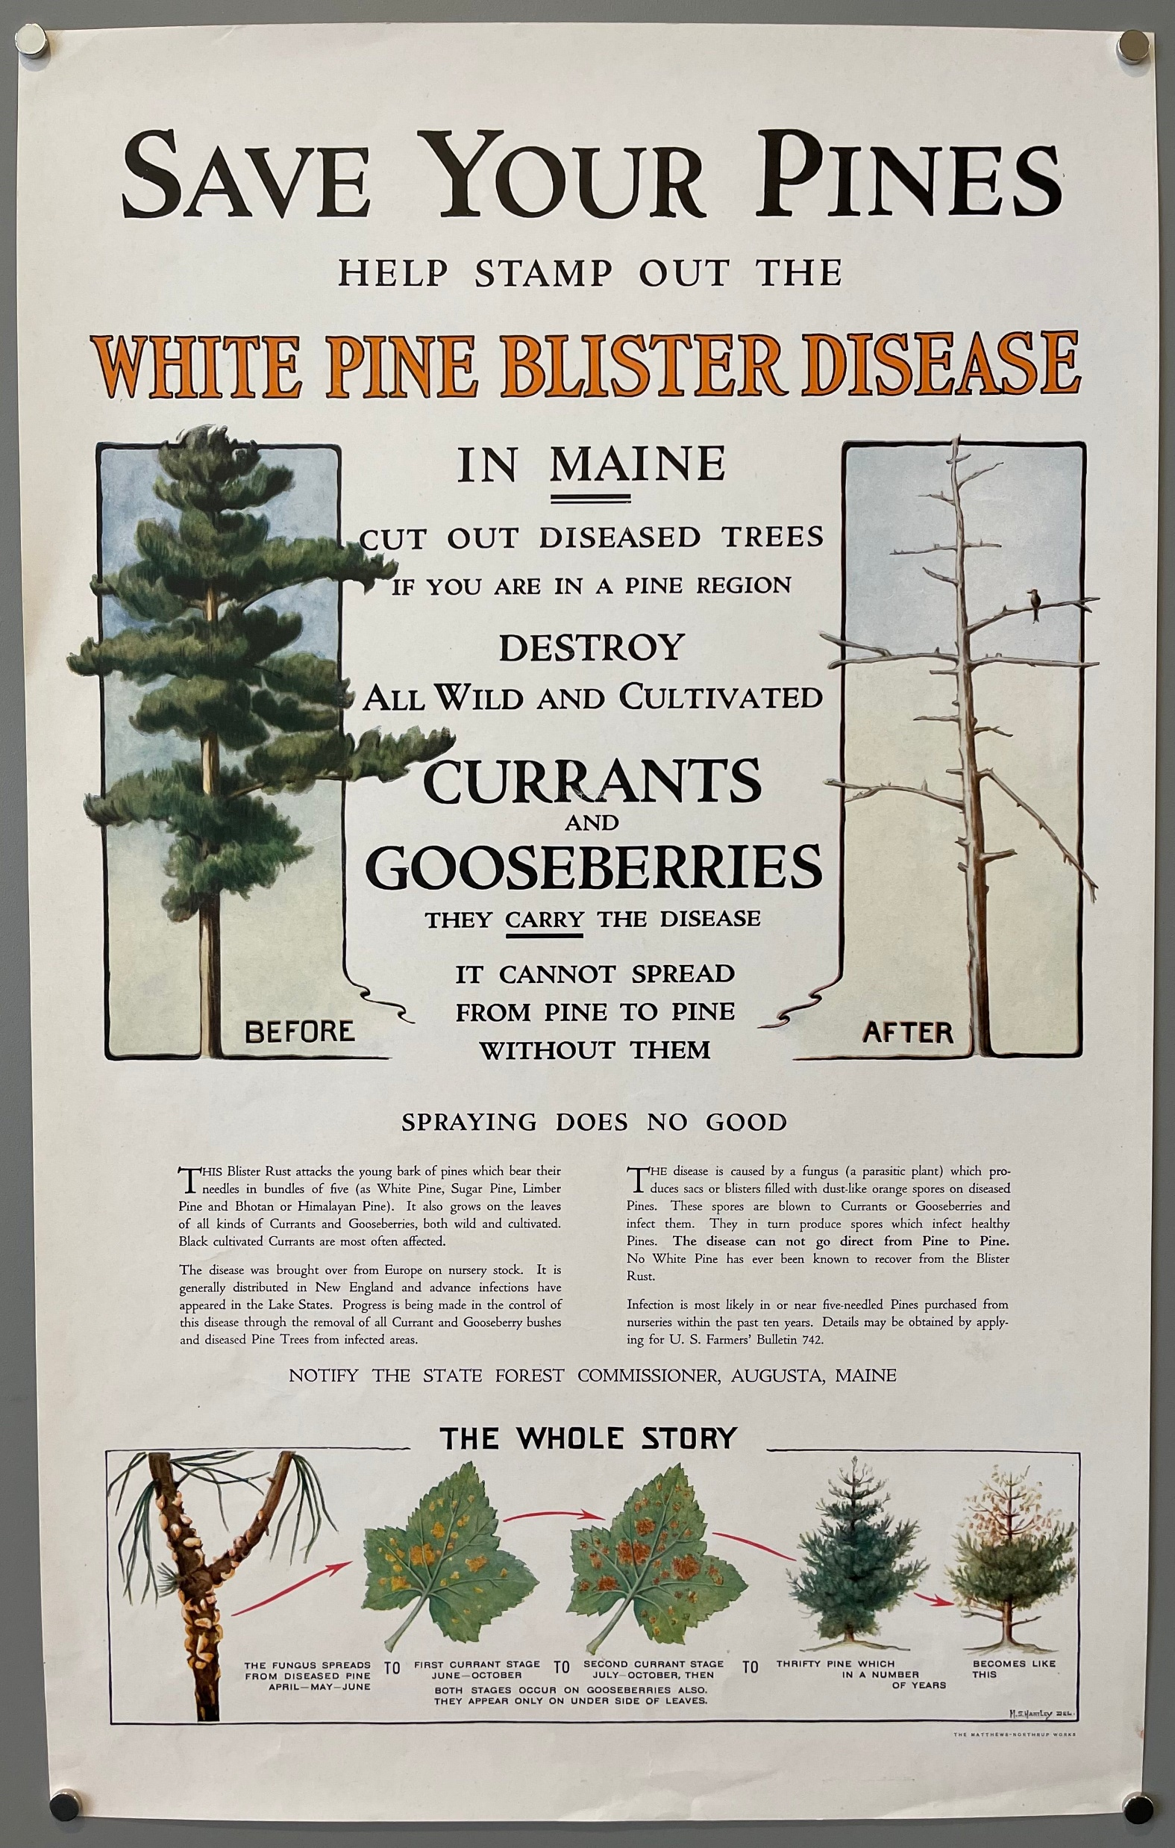
Eradication of Ribes
Huge eradication effort from 1917 to 1968
Full-time, seasonal, and CCC crews
Overall, wasn’t feasible
Grew back
Spores disperse farther than removal radii
Additional alternate hosts
Removal efforts could be justified
Few plants and easy to locate
Museum of North Idaho / The Spokesman-Review

Slide 13
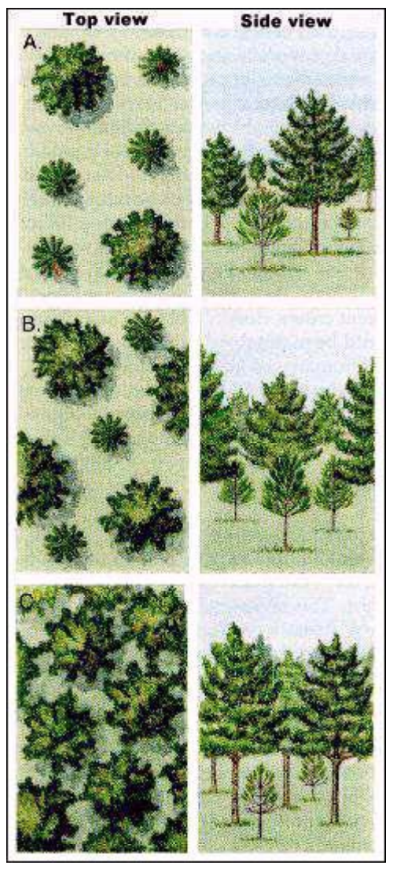
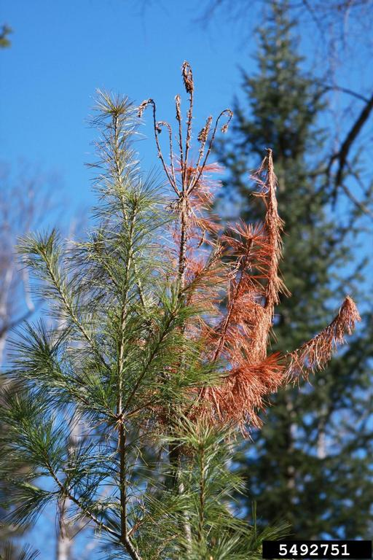
Where and how to plant white pine
Best to manage white pine under an existing overstory
Grow white pine under an overstory with 40-50 percent crown closure
Grow white pine in high densities
6 x 6 ft. spacing
Thin when trees reach 20-24 ft. in height
Same management for white pine weevil
Steven Katovich, USDA Forest Service, Bugwood.org
USDA Forest Service

Slide 14
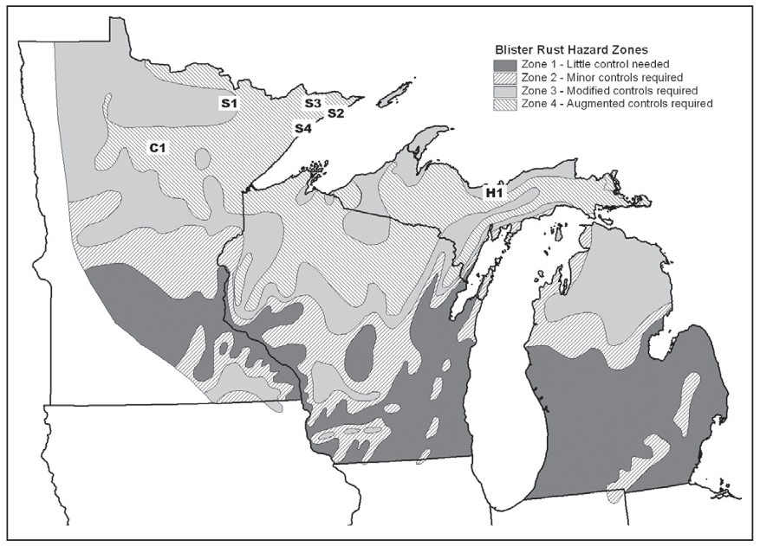
Where and how to plant white pine
Avoid planting in depressions, small canopy openings, north aspects, west aspects, and slope bases
North Shore is in zone 4
Control is needed
Think about management for other issues in addition to blister rust
USDA Forest Service

Slide 15
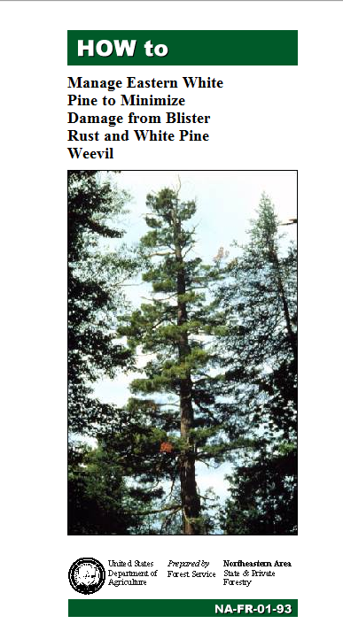
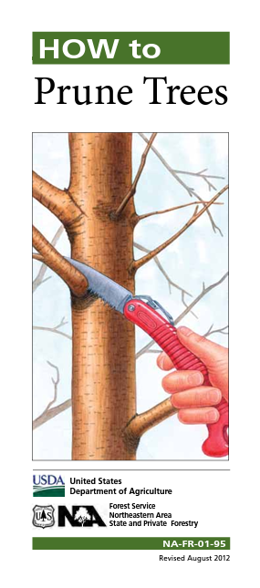
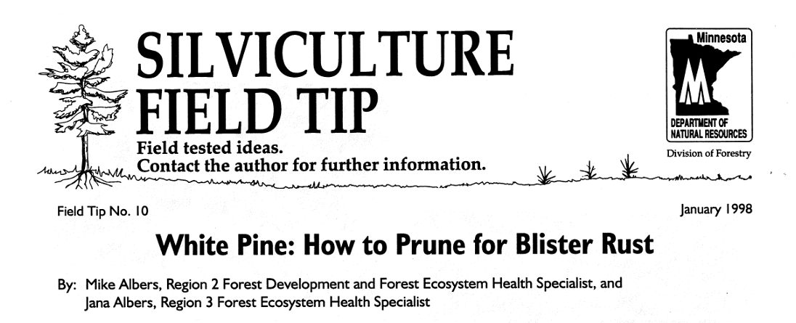
Resources

